Slide 1
Reading Elective Presentation - II
By : Munagala Kalyan Ram

Slide 2
JSON-LD (LD = Linked Data)[Link]
JSON-LD is a lightweight Linked Data format and is based on the JSON format. It provides a way to help json data interoperate at the Web-Scale. Allows to define the meaning of the attributes in a json through the “@context” key.
It has 2 form : Expanded Form (Easy for humans to read) and the Compact Form (Easy for machines to read)
The features provided include Types, Aliasing (Specified in @context), Nesting , Language (@language : “jp”), etc.
Types : Object Types (Person, Place,etc) , Data Types (int, xsd:date, etc) [ Denoted by @type ] . Additionally , Type Coercion is their where the type is defined in the context and reused multiple times in the body.
Graphs can be implemented between different Linked Data using @graph which an array of @knows( basically a link to another data object).
There are 2 types of linking : Embedding (Inside the same json object) and References(through link)

Slide 3
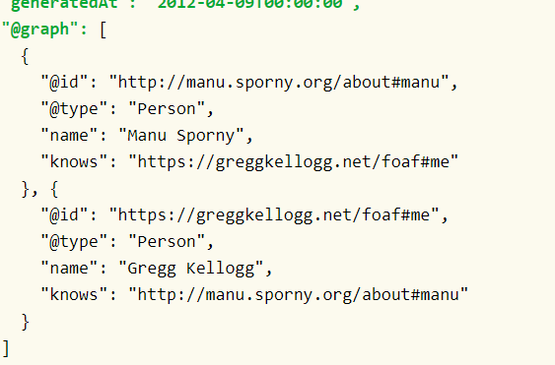
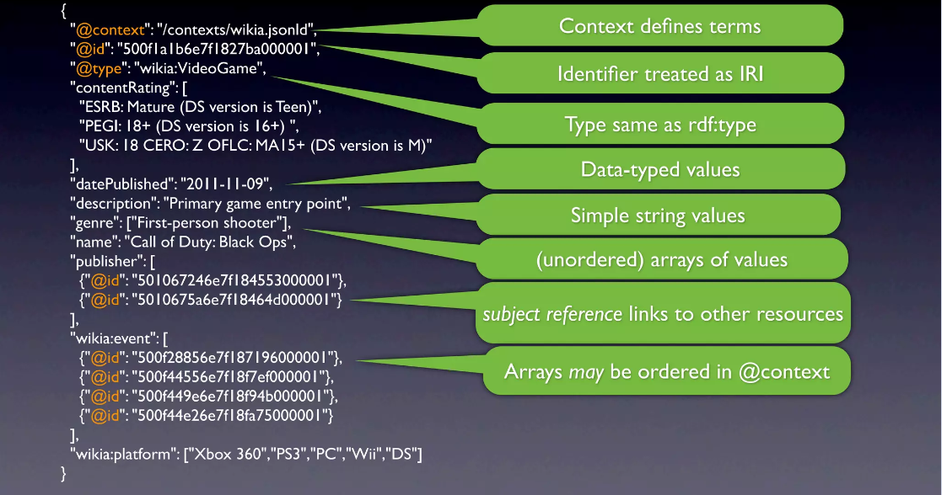
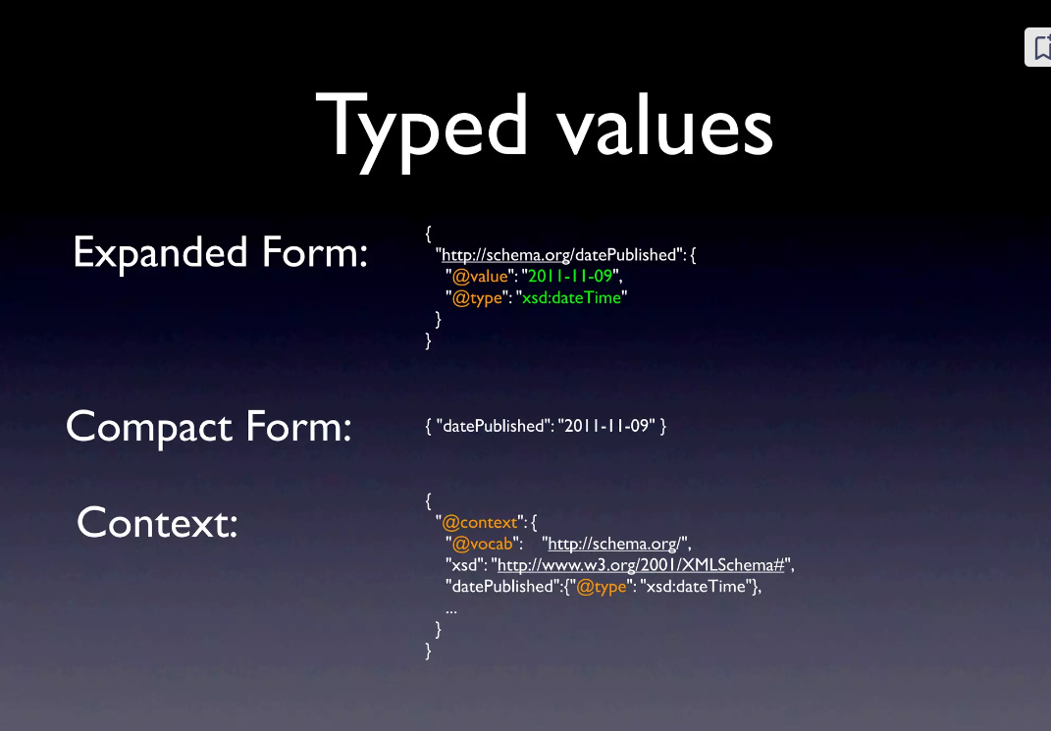
JSON-LD (LD = Linked Data)[Link2 , Link3]

Slide 4
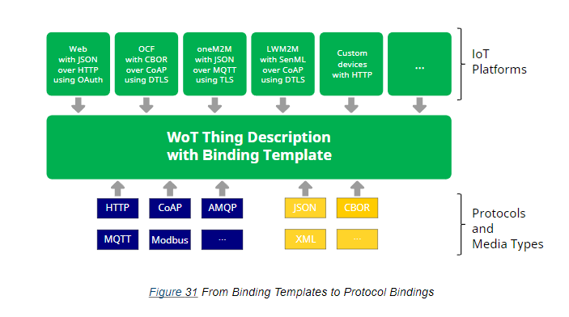
Binding Templates[Link]
Enables Interaction with different IOT platforms (LwM2M, OPC UA, OneM2M) , standards ,protocols , and devices with no standard format.
Based on the protocol, media type or platform , a Thing Description is created and a consumer uses this and the Binding Template (Blueprint of the conversion) to get the required information. Also provides a mapping from the Thing Description given from WOT consumer to the appropriate format of payload and the protocol along with the platform specific attributes.

Slide 5
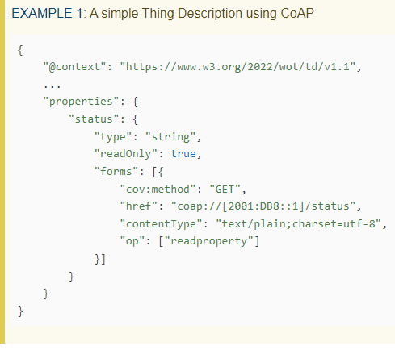
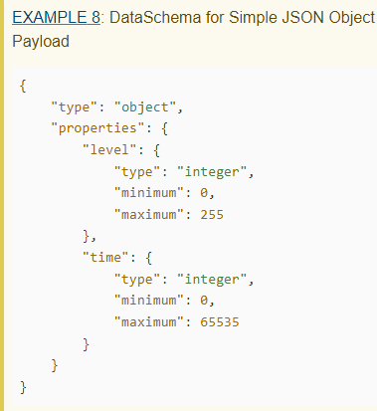
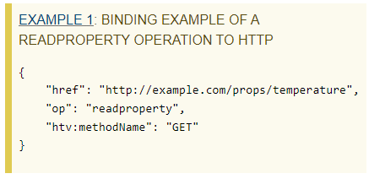
TDs can be bound to specific protocols, payload formats and platforms. This is possible through 3 mechanisms : Protocol Binding, Payload Binding and Platform Binding (combines the previous 2 with platform specific additions).
Protocol Binding Mechanism : A Thing Description defines the abstract operations like “readproperty”,” invokeaction”, etc that describe the intended semantics of a protocol. Protocol binding of CoAp
Payload Binding Mechanism : Specified in the Thing Description using “ContentType” and describing the Data Schema (Describes structure of message).
Example of data schema for json with 2
Attributes (level and time)

Slide 6
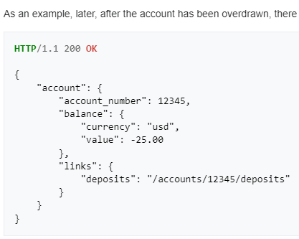

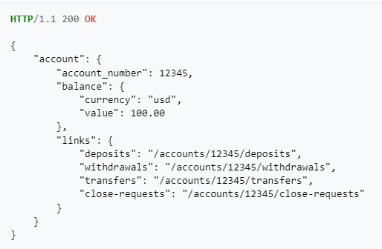
HATEOAS[Link1 , Link2]
HATEOAS stands for Hypermedia as the Engine of Application State and it is a constraint of the REST application architecture. Aims to support new features along with existing ones.
A client can interact with the server using HATEOAS dynamically through hypermedia(links, i.e When a user makes a request, the response is sent along with the links to the next set of requests that can be sent at any given state of the application.
This means that as the state of the application changes through get or post requests, the links the user receives for the next action will also change.

Slide 7
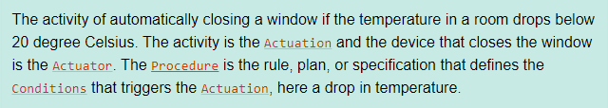
Semantic Sensor Network Ontology (SSN) [Link]
Ontologies are used to define the relationship, properties, classes and subclasses of objects. They provide a formal and structured way of representing data that makes it easy for machines to interpret.
SSN is an ontology for describing sensors, their observations and also describing the actuators. It is built on top of SOSA (Sensor, Observation, Sample , and Acutator) ontology. It is meant to be aligned and integrated with the Linked Data used by WOT.

Slide 8
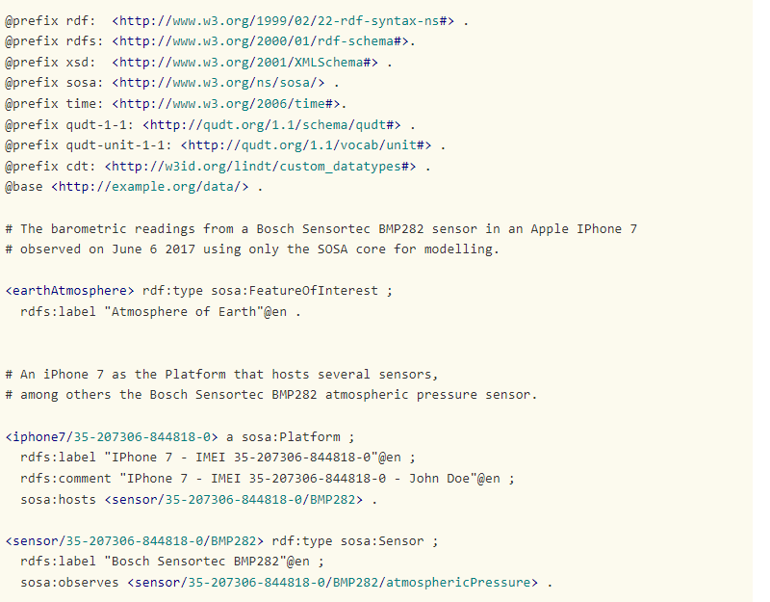
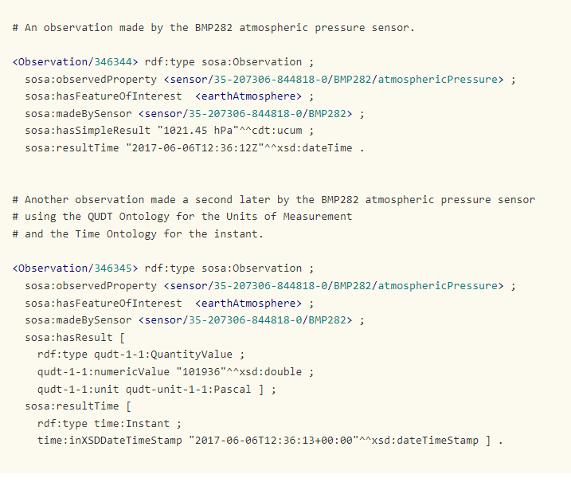
Example : Iphone Barometer

